Slide 1
Developing an Evidence-Based Framework for Bypass and Widening Projects and the Effects on Communities
TRC1904
Presented by
Sarah Hernandez (PI)
For
108th TRC Transportation Conference & Equipment Expo
Hot Springs, August 14-16, 2019
Notes:
Good morning everybody, and thank you for being here. I’m going to present one of the projects being developed at the UARK or ARDOT, and in particular, for the planning division.
As you know, many communities are developed around a “main road”, which may be a US highway, for example, that at some point becomes congested. In order to solve these capacity issues, and to generate economic development, these communities typically face the decision of whether to wider the main road, build a bypass of such road around town, or do nothing. In particular, some members of the public may be concerned that the construction of a bypass may hurt business located downtown, on the main road. So, what can we do to inform the public about the actual effects on communities of previous bypass and widening projects? We are developing an evidenced-based framework to do that.

Slide 2
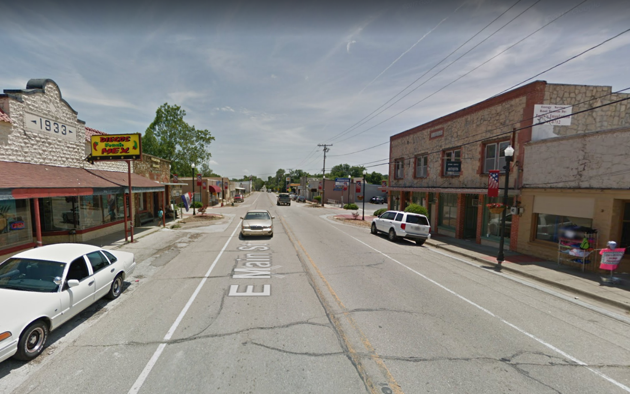
Project Motivation
"This is the third hearing we've had on the proposal and we're getting some excellent input and legitimate concerns," [Randy] Ort said.
"The traffic congestion has to be relieved somehow and we can't widen our road in downtown because of all the beautiful historic buildings we have in downtown Flippin," said Flippin Mayor Mary Jane Erwin. "The closer we can keep the bypass to the downtown area the better off the businesses are."
"We're for the bypass if it turns out that it won't hurt the small businesses in the area," agreed Eldawan "Sug" and Beverly Wagoner.
"If the bypass moves the traffic and not the city, I'd probably be for the project," said Fancher. "My main concern is that the bypass might limit the amount of traffic and business that keeps downtown Flippin alive."
Flippin, Arkansas
https://bolivarmonews.com/home/bypass-routes-among-alternatives-at-flippin/article_43636d47-25a8-53a0-bee0-d52653593149.html
Notes:
Current traffic volumes range from 7,800 to 11,000 vehicles per day with approximately 10 percent of those being trucks.

Slide 3
Objectives
Select projects
Bypass
Widening
No improvements
Evaluate economic, social and environmental impacts.
Develop an evidence-based approach to decision making to benefit small towns who face similar decisions.
Notes:
The core objectives of this project are:
- first, to measure the economic, social, and environmental impacts of past projects in communities that have already taken the decision of whether building a bypass, widen an existing road, or decline improvements,
- and then, based on those impact measures, to develop an evidence-based approach to support similar decisions in other towns.

Slide 4
University of Arkansas Team
PI: Sarah Hernandez
Department of Civil Engineering
Assistant Professor
sarahvh@uark.edu
Researcher: Muhammad Rahman
Walton College of Business
Department of Economics
Clinical Assistant Professor
Research Assistants:
Magdalena Asborno, PhD Student, CVEG
Sanjeev Burthyal, PhD Student, CVEG
Fu Durandal, MS Student, CVEG
Karla Diaz Corro, Undergraduate Student, CVEG
Rebecca Hardwick, Undergraduate Student, CVEG
Annabelle Lacrue, Undergraduate Student, CSCE
Madeline Giebler, Undergraduate Student, CVEG
Beth Fancis, Undergraduate Student, CVEG
Co-PI: Mervin Jebaraj
Center for Business and
Economic Research
Director
mjebara@uark.edu
Notes:
The University of Arkansas team involved in this project is led by Dr Sarah Hernandez, who couldn’t join us today, but she is the Principal Investigator. The research team is comprised of professionals from both the College of Engineering, in particular the Civil Engineering Department and the Walton College of Business.

Slide 5
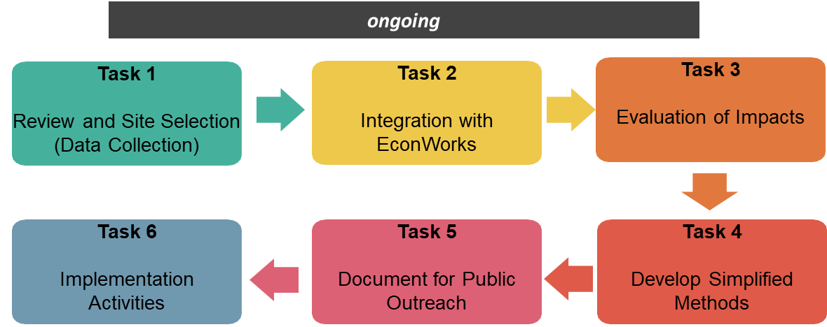
Tasks
Notes:
This is an ongoing project.
In order to deliver such objectives, first we need to collect data and identify study sites, which is what we are doing today.
We are also familiarizing with EconWorks (we’re going to talk about it in a minute)
Later, the team will evaluate economic, social, and environmental impacts of the selected sites, and develop simplified impact evaluation methods.
Then, we will generate documents for public outreach, which consists of templates with main impact findings/ conclusions to support future decisions, and
lastly, the selected sites will be implemented into the EconWorks platform.

Slide 6
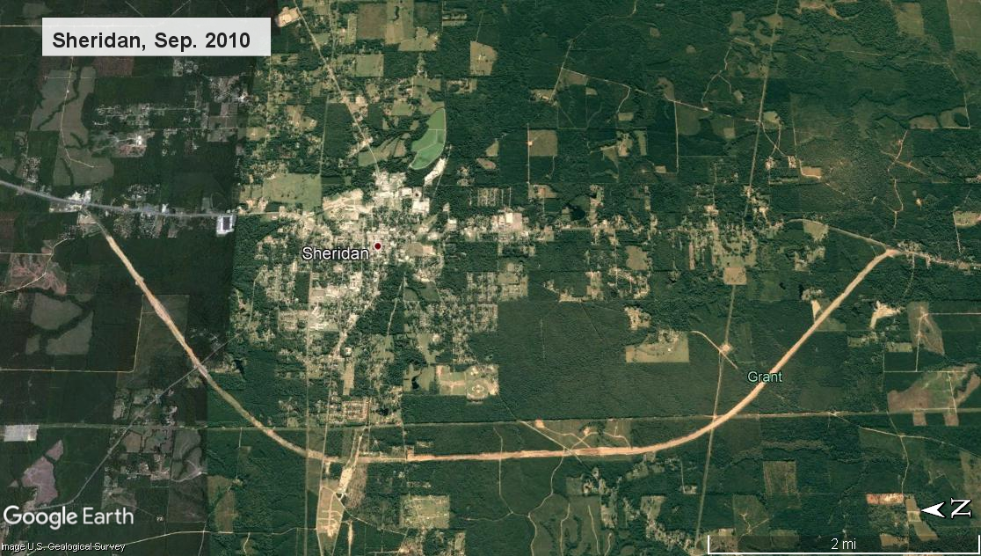
Presentation Outline
Background on impacts of highway projects
Explain how the project fits into an FHWA initiative for EconWorks
Overview of the study sites and their characteristics
Example of the Grady bypass and Siloam Springs widening projects
Description of the matched pairs city selection process
Sheridan, AR Bypass (2010)

Slide 7
Background: Positive and adverse impacts of highway projects
Positive Impacts
Adverse Impacts
Congestion relief on main route
Economically distressed areas do not benefit from direct jobs
Trucks detour to bypass
Misaligned land use policies and poor complimentary infrastructure can reduce positive impacts
Fewer vehicle and pedestrian accidents on main route
Total sales often increase
It depends…
Economic impacts on small and medium communities are mixed
Travel related and big box business relocate to bypass, service businesses unaffected
No clear trend for property values
Sprawl and population growth are mixed
Sales by industry are mixed

Slide 8
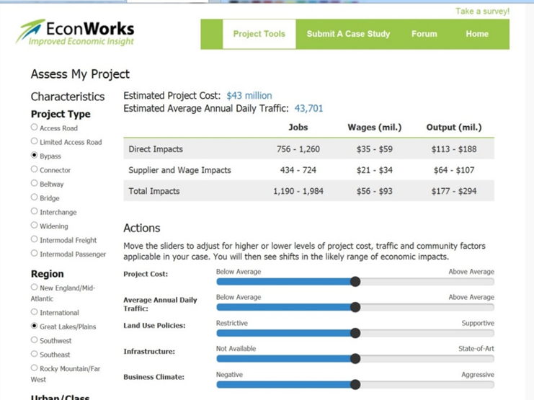
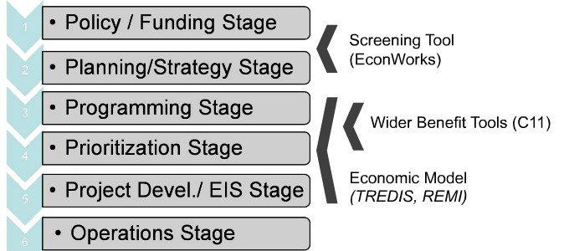
EconWorks: An FHWA Tool Kit for Economic Impact Analysis
SHRP2 Program from FHWA
Used for economic impact assessment
EconWorks tool comprises a library of 100 case studies across the U.S.
EconWorks Output for Iowa Bypass (IDOT, 2015)
Notes:
Spend more time explaining what Econworks is. Explain the graph on the left as well.
So, one of the deliverable of this project is to implement the findings of selected sites into Econworks.
For those of you who are not familiar with it, Econwoks is a web-based set of tools, designed to help planners to assess and explain details of transportation projects. It was already tested and successfully implemented in SHRP2 programs, and it comprises a library of 100 transportation projects across the U.S.
As you can see in the table on this slide, only a few of these 100 projects or case studies in the Econworks Library constitute bypass or widening projects. And if you wanted to find a “similar project” to compare with a potential decision your community is facing, you may need to narrow down the case study search to find not only similar projects (in terms of project type, purpose, length, investment, etc.) but also delivered in sites or cities of similar characteristics (in terms of population, density, volume of traffic, etc.). The more specific the search becomes, the more difficult to find a “similar project” in Econworks is.
So, by incorporating more projects, and in particular, a wider variety of projects into Econworks, which is one of the deliverables, we would be improving the tool.
https://www.fhwa.dot.gov/goshrp2/Solutions/Capacity/C03_C11/EconWorks

Slide 9
EconWorks: Project requirements
Completed for a least five years
Economic development as key motivation
Must have a highway component
Possess all required data…
EconWorks Case Study Library
Type | Case Studies | Project Setting
 |  | Metro | Rural | Mixed
Bypass | 13 | 4 | 8 | 1
Widening | 9 | 4 | 2 | 3
All | 100 | 56 | 23 | 21
Notes:
But not any project can make it into Econworks, at any time. There are some requirements that projects need to meet to be incorporated into Econworks, such as completion date, motivation, etc. But one of the main challenges related to incorporating projects on Econworks has to do with data availability. Some projects may be too old, and the data that is required may not be available. Or maybe the project is too new, (and we couldn’t make a proper comparison of site characteristics before and after the project was built).

Slide 10
EconWorks: Case study data requirements
Key Areas | Data Elements
Project Documents | Project description Location Construction start and end dates Capital costs Size/scale of the project
Project Setting | Highway network density Topography Transportation accessibility
Economic | Economic distress level Project impacts (employment, per capita income, property value, business sales, tax revenue).
Transportation | Annual average daily traffic (AADT) Vehicle miles traveled (VMT)
Demographic | Population characteristics Population density Rural or urban setting Region of the US
1 year before project start
&
5 years after
project
completion
Notes:
Let’s take a closer look at the data characteristics that Econworks requires from each case study.
Basically, the requirements includes project-specific data (like construction start and completion dates, cost, type, length, etc.), project setting (topography, highway network density, transportation accessibility), and
Site characteristics. Economic characteristics, transportation characteristics, and demographics.
And all this quantitative and qualitative data elements are needed both before and after the project was completed.

Slide 11
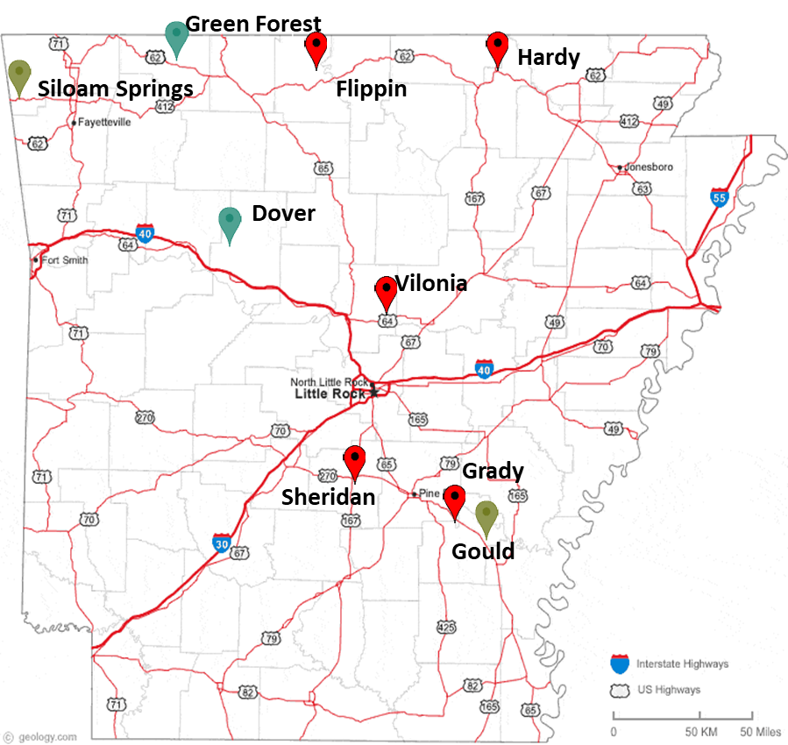
Study Sites: Locations
Project Treatment
Bypass
Widening
No Improvement
Notes:
This is a map showing potential study sites. Each of these sites took a decision of whether to widen an existing main road (Gould, and Siloam Springs), build a bypass (Grady, Sheridan, Hunstville, Hardy, and Vilonia), or do nothing (Dover and Green Forest). You can notice form the map how spread the sites we are working on are.

Slide 12
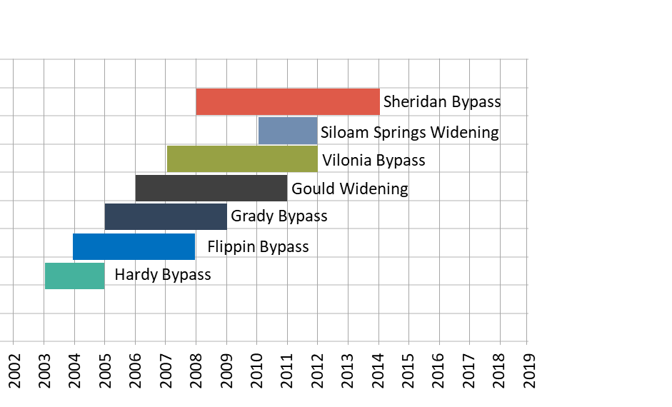
Study Sites: Construction Start and End Dates
Notes:
The projects on the sites we just saw on the map in the previous slide took place in different years, with a broad range, between 1992-2015.
Some of these sites may be dropped from the study and others may be added, if after the data analysis it is concluded that they don’t comply with Econworks requirements.

Slide 13
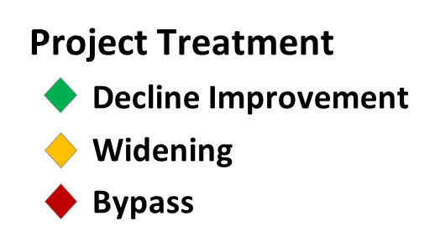
Comparison: County Population Before and After
Notes:
Here we can see a before and after comparison of the population of all sites (in thousands of people). This graph adds to the radial graphs we just saw, in that it gives us the possibility to see order of magnitude of the population in each county site is, and how similar or different it is to other sites. For example, we see that in 5 out of 9 sites the population increased, in one site it reduced (Gould)< and in the remaining 3 sites it didn’t change.

Slide 14
Comparison: County per capita income (PCI) before and after
Notes:
And in this graph we compare the PCI for each site (County). When we compare the change in PCI, we see that all counties where the project was delivered have increased their PCI, with the exception of Huntsville.

Slide 15
Study Sites: Documents and Data
Environmental Assessments
Project Status Reports (SARS)
Public hearing synopses
Public involvement synopsis
Advance Location and Design Guide Criteria – Project Planning Committee
Construction drawings
Interoffice memorandums
Site | Project Chara. | Pre Study Period | Post Study Period | Project Impacts | Highway Chara. | Overall Availability
Grady | 83% | 67% | 88% | 0% | 100% | 71%
Hardy | 83% | 67% | 88% | 0% | 50% | 70%
Flippin | 75% | 67% | 88% | 0% | 100% | 69%
Sheridan | 88% | 67% | 88% | 0% | 100% | 72%
Vilonia | 88% | 75% | 88% | 0% | 100% | 75%
Gould | 88% | 67% | 88% | 0% | 100% | 72%
Siloam Springs | 88% | 88% | 88% | 0% | 100% | 78%
Dover | 63% | 88% | 88% | 0% | 100% | 71%
Green Forest | 63% | 88% | 88% | 0% | 100% | 71%
Notes:
For the sites you saw in a previous slide, we looked for the econworks required data first in project Documents provided by ARDOT, such as Environmental Assessments, Project Status Reports, Minutes of meetings with the public, construction drawings.
These documents are very good to collect project-specific data (cost, schedule, purpose -and actually they may be the only available source). But they have to be supplemented with external sources to collect mainly demographics and economics data.

Slide 16
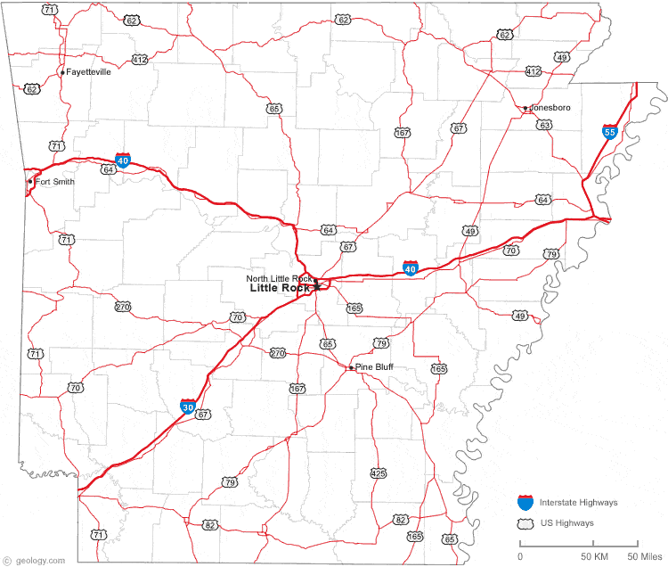
Example: Grady Bypass Site Characteristics
Start Year: 2005
Completion Year: 2009
Total Cost: $24 million
Length: 4.2 miles Highway 65
Location: Southeast AR - Lincoln County, near Pine Bluff, Metro Setting
Purpose: Bypass needed to accommodate for traffic congestion due to local, school, and agricultural traffic
GRADY
Reference Date | Population | Per Capita Income(2018$) | Economic Distress
2004 | 14,137 | $25,875/person | 1.4
2016 | 13,810 | $26,321/person | 0.98
Change | -2.3% | +1.72% | Improved

Slide 17
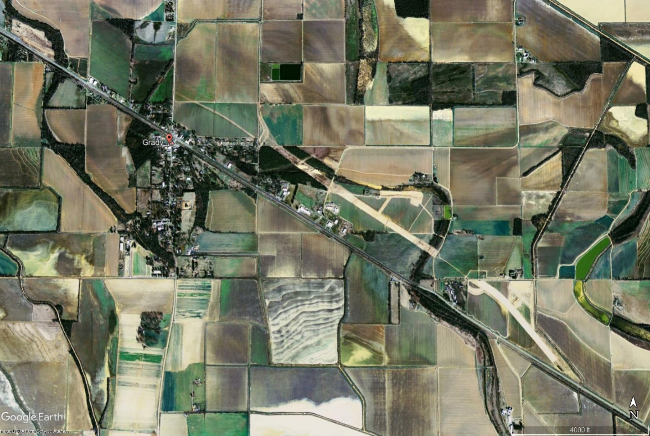
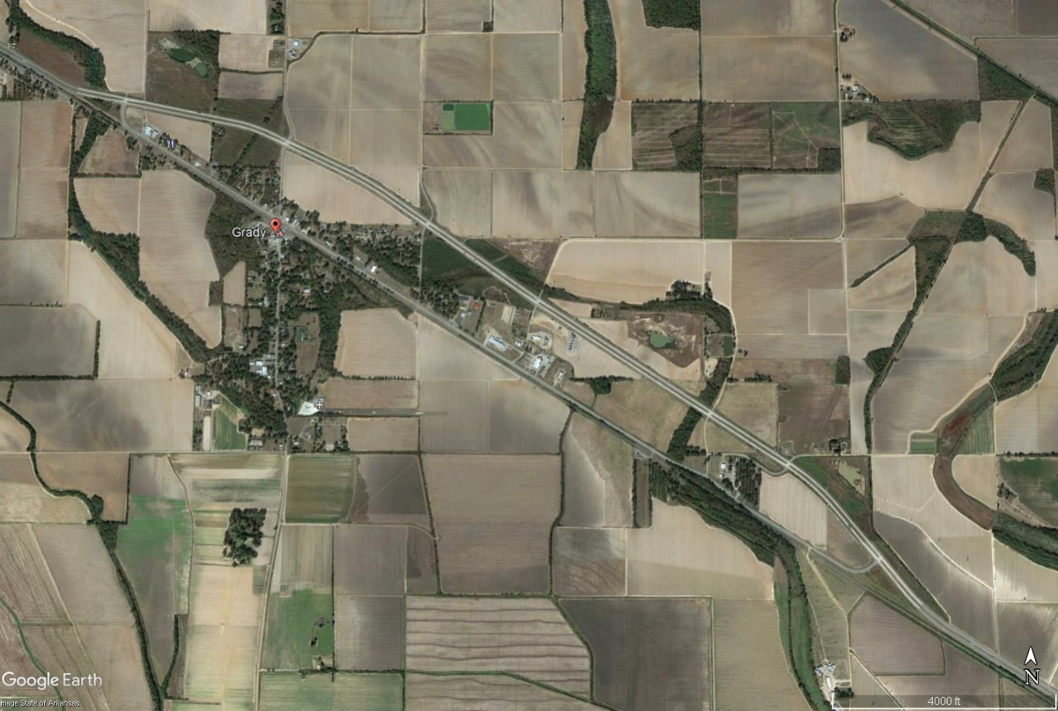
Example: Grady Bypass Aerial Images
Before (2006)
After (2015)

Slide 18
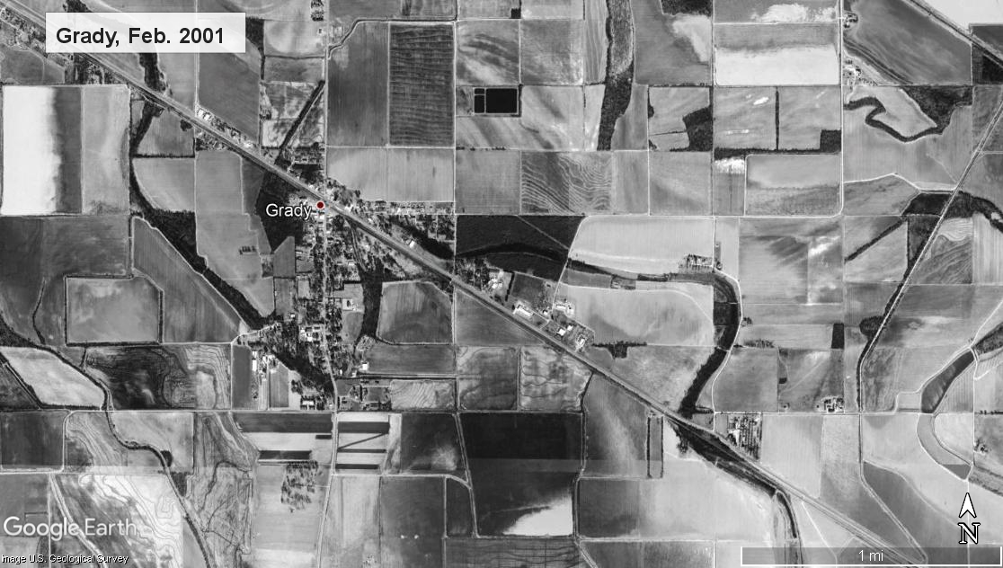

Slide 19
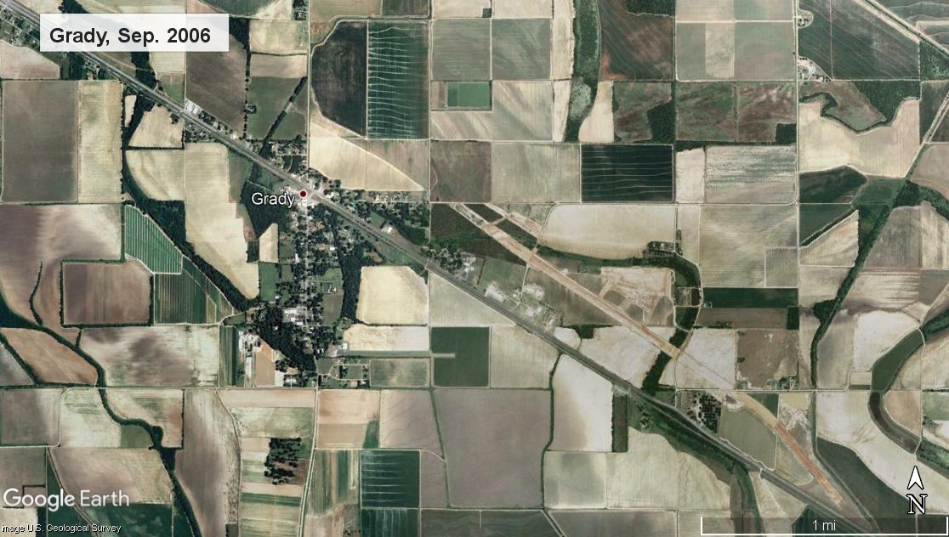

Slide 20
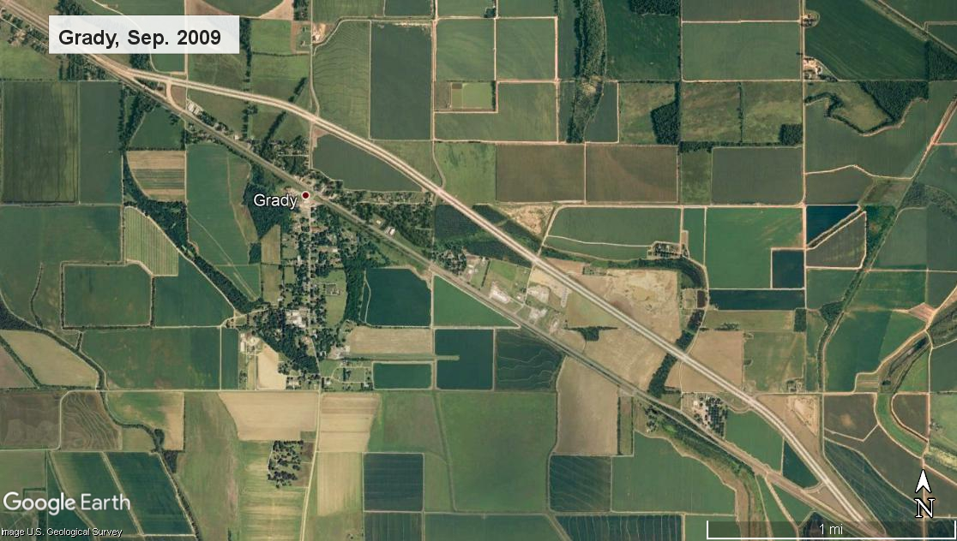
Fun Park
Residential House

Slide 21
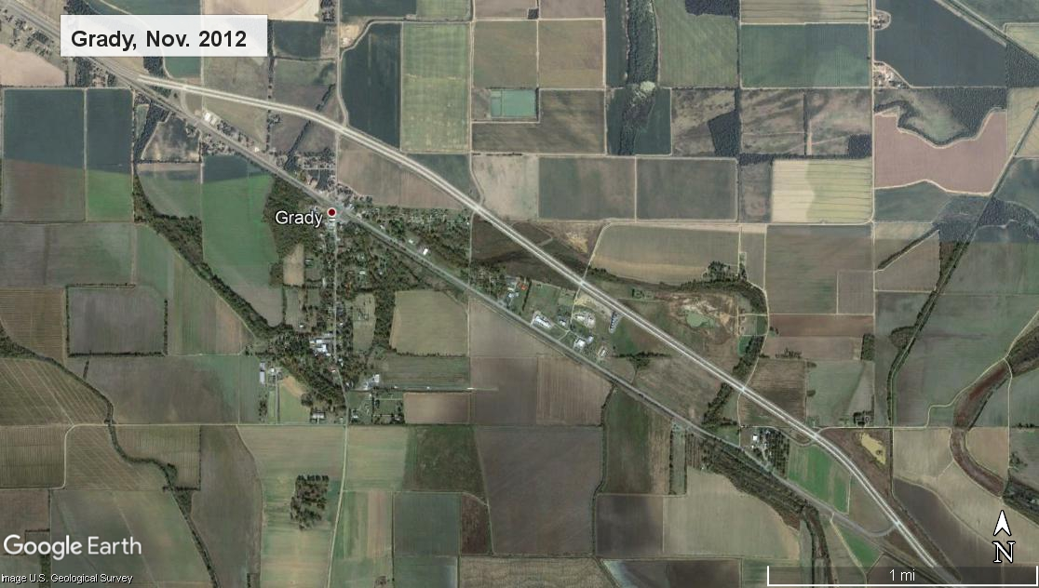
Fun Park
Residential House
Valley View Agri

Slide 22
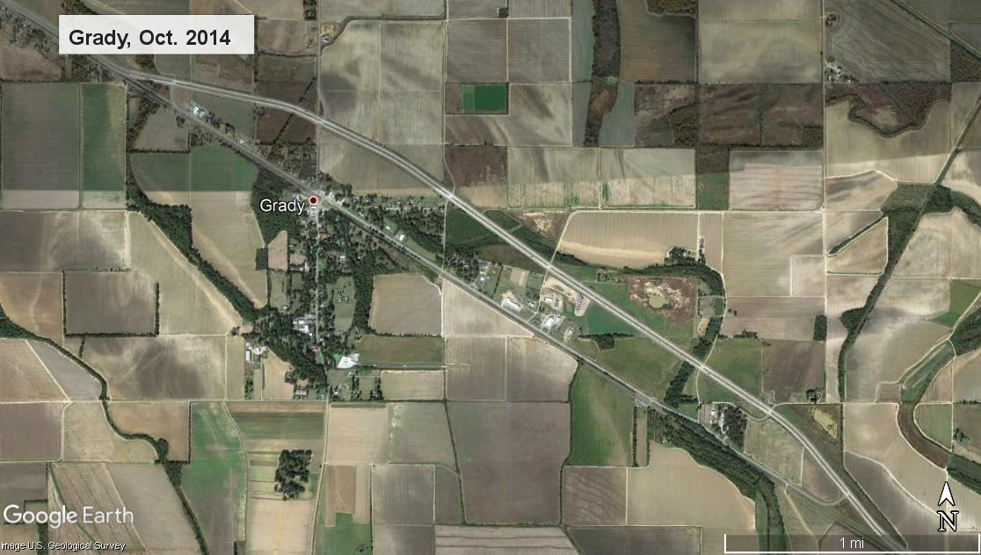
Fun Park
Residential House
Valley View Agri

Slide 23
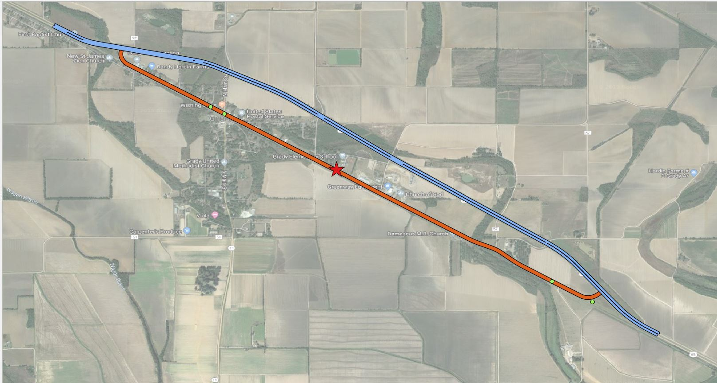
Example: Grady Bypass Crash Occurrence
Bypass Construction
Bypass
Main street

Slide 24
Site Comparisons: Economic Setting and Project Characteristics of Bypass Projects
Notes:
This is the radial graph to compare Bypass projects. Building upon the comparison of shapes, projects, and impacts, you can see that all polygons are quite different, there are not two polygons that are the same. So, the main conclusion we take from this graph is that the sites we are analyzing are representative a good variety of projects and impacts.

Slide 25
Example: Siloam Springs Widening Characteristics
SILOAM SPRINGS
Start Year: 2010
Completion Year: 2012
Total Cost: $14 million
Length: 1.6 miles Highway 412
Location: Northwest Arkansas at Benton County, Metro
Purpose: Relieve increasing traffic congestion, reduce traffic delay, and improve travel safety on Highway 412
Reference Date | Population | Per Capita Income(2018$) | Economic Distress
2009 | 225,504 | $56,315/person | 0.69
2017 | 266,300 | $83,612/person | 0.66
Change | +18% | +48% | Improved

Slide 26
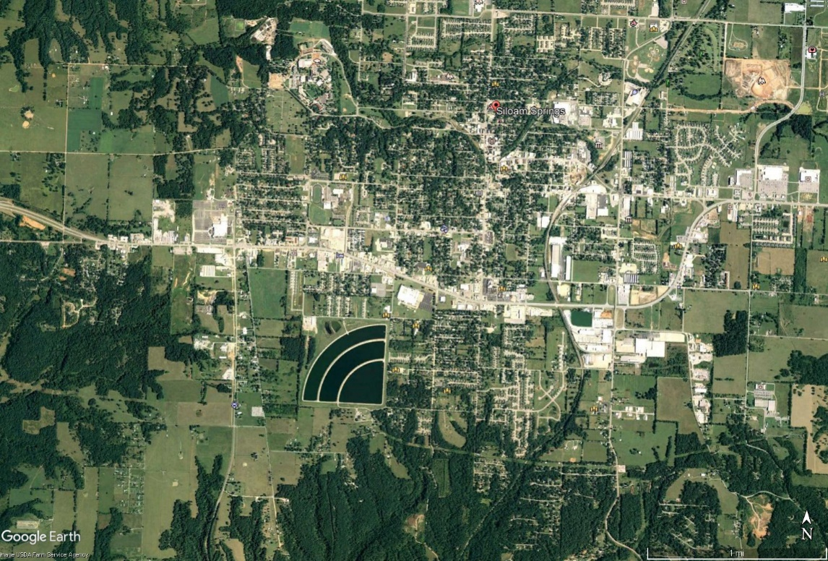
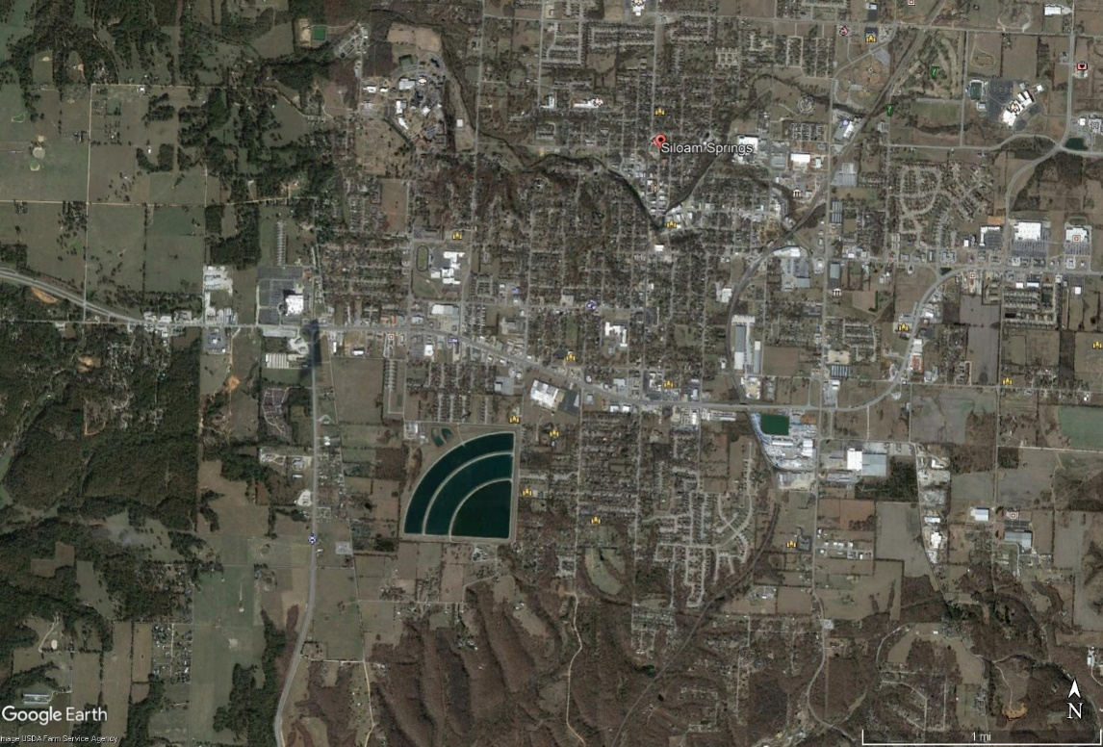
Example: Siloam Springs Widening Aerial Images
Before (2009)
After (2017)

Slide 27
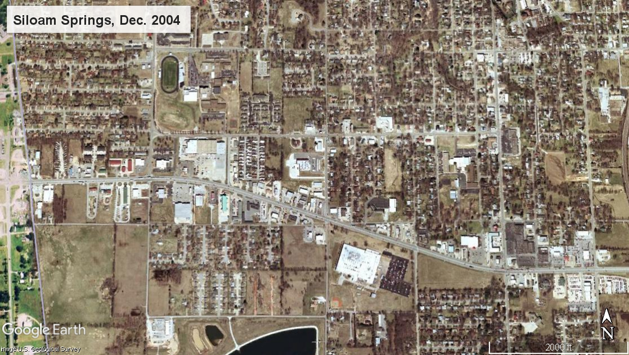

Slide 28
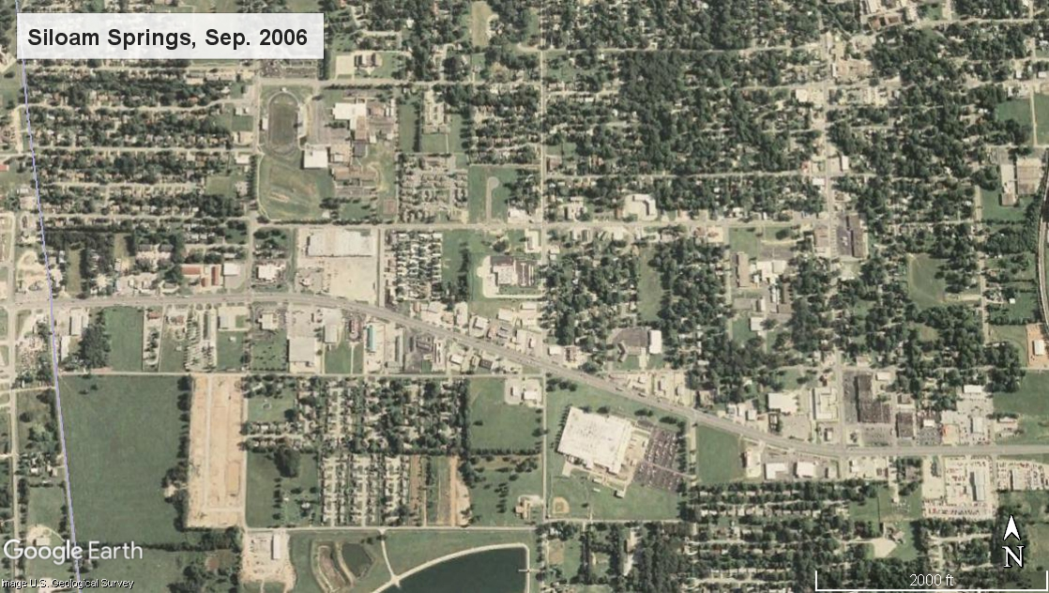
Siloam Collision Center
Eureka Pizza, Dollar General

Slide 29
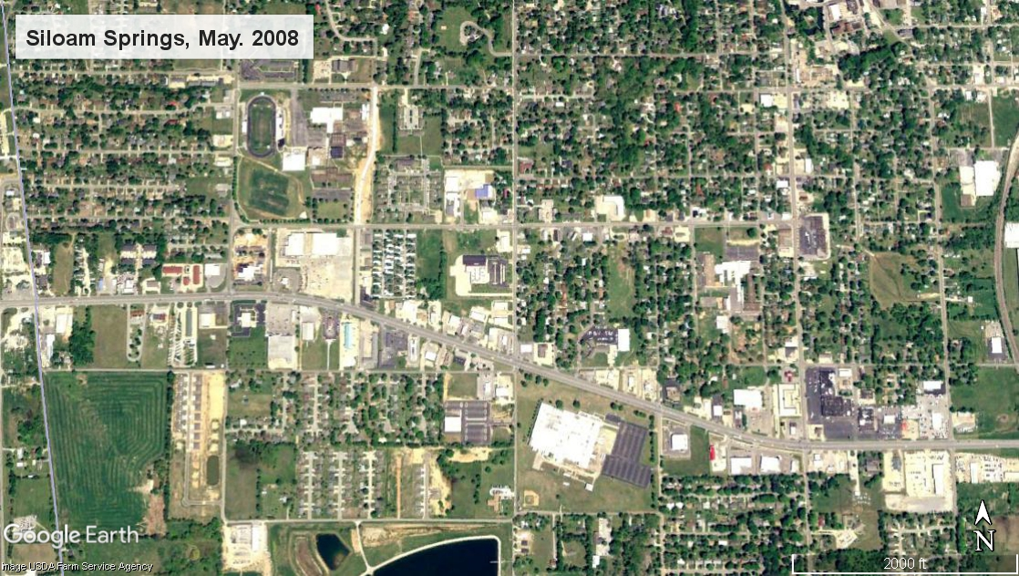
Boys and Girls Club-Siloam Spg
Siloam Collision Center
Siloam Springs 6 Theater
Walgreens
Eureka Pizza, Dollar General

Slide 30
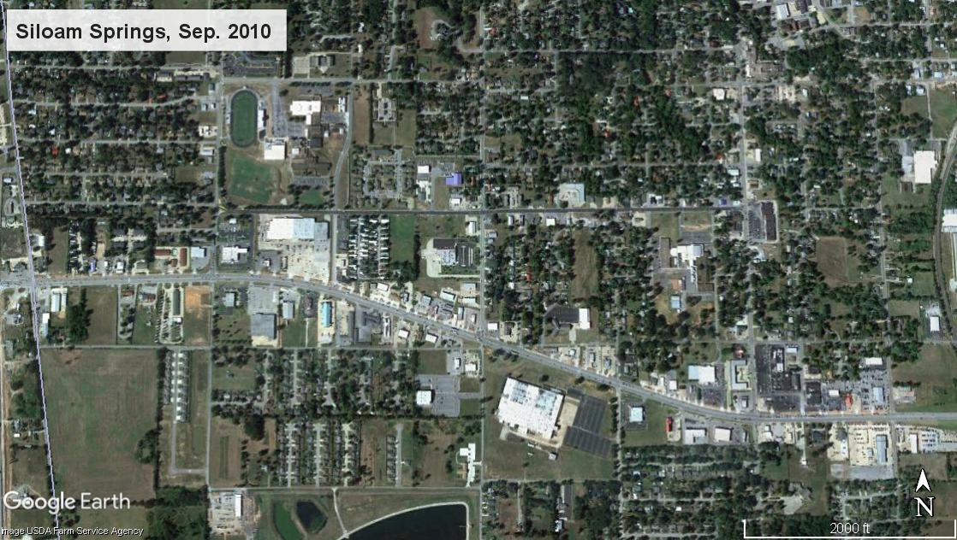
Boys and Girls Club-Siloam Spg
Siloam Collision Center
Siloam Springs 6 Theater
Walgreens
Church
Eureka Pizza, Dollar General

Slide 31
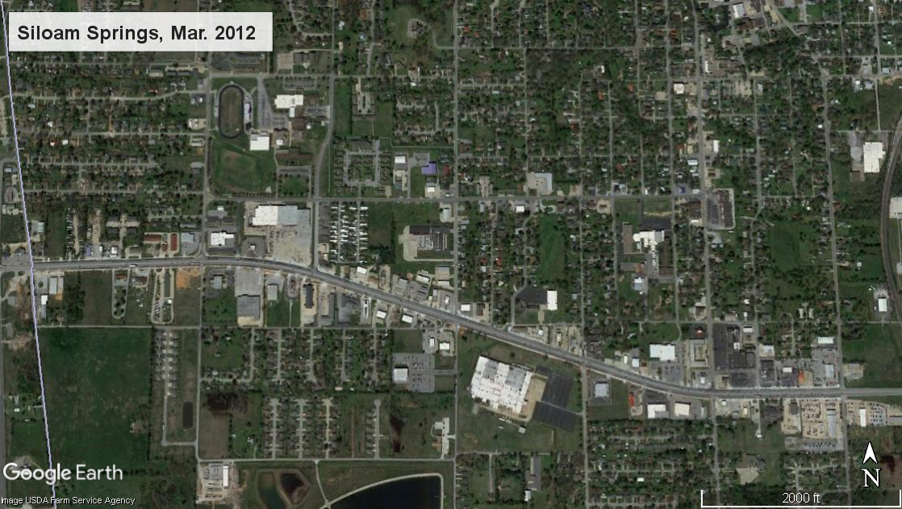
Boys and Girls Club-Siloam Spg
Siloam Collision Center
Siloam Springs 6 Theater
Walgreens
Eureka Pizza, Dollar General
Church

Slide 32
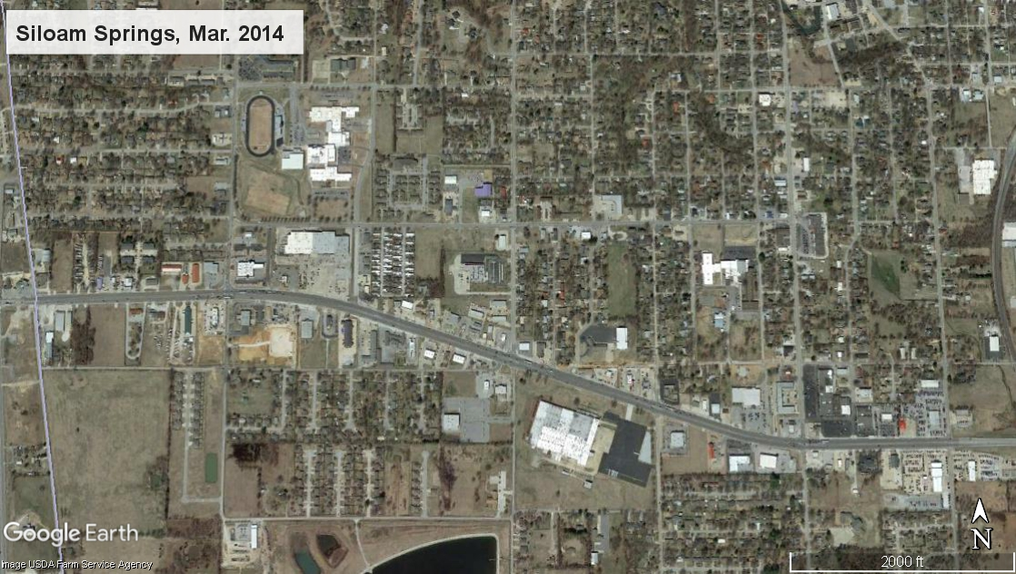
Residential Houses
Boys and Girls Club-Siloam Spg
McDonald’s
Siloam Collision Center
Siloam Springs 6 Theater
Walgreens
Eureka Pizza, Dollar General
Church

Slide 33
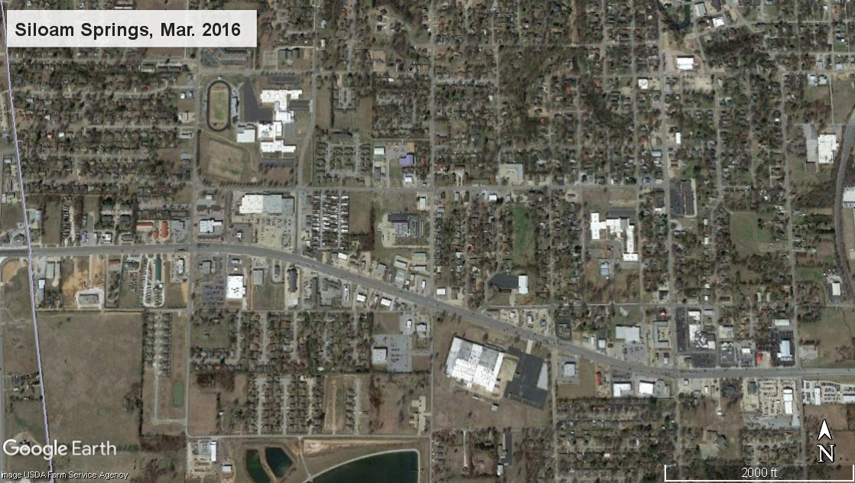
Residential Houses
City of Siloam Springs Public Library
Boys and Girls Club-Siloam Spg
McDonald’s
Siloam Collision Center
Walmart Neighborhood Market
Siloam Springs 6 Theater
Holiday Inn Express & Suites
Walgreens
Eureka Pizza, Dollar General
Church
City of Siloam Springs Electric Warehouse

Slide 34
Example: Siloam Springs Crash Occurrence
Widening Construction

Slide 35
Site Comparisons: Economic Setting and Project Characteristics of Widening Projects
Notes:
The site characteristics we just saw are project-specific. However we are interested in comparing the project characteristics and effects of different sites. To do this comparison we utilize radial graphs, like the one you see in this slide for Widening projects. Each shape of a different color represents a different project. The more similar the shapes of the polygons, the more diverse the projects are.
You will note that the project charcateristics (cost, duration, length) are located in the bottom-left of the radial graph, while the impacts (population change, density change, and PCI change) are located in the top-right. SO we can also compare how similar or not the shape of each project is in each hemisphere of the graph. In this particular case, the projects are quite different, but the impacts are even more different.

Slide 36
Matched Pairs: Selection of Cities for Comparative Analysis
Average Percentage Difference
Population, PCI, Density, etc.
Project Setting
Urban vs. rural
Crash Rate
Crashes on “main street”
Highway Improvement
Presence of any other highway improvement project in the past
Highway network characteristics
Distance and location relative to interstate and highway
Matched City
One or multiple matched cities to each project site

Slide 37
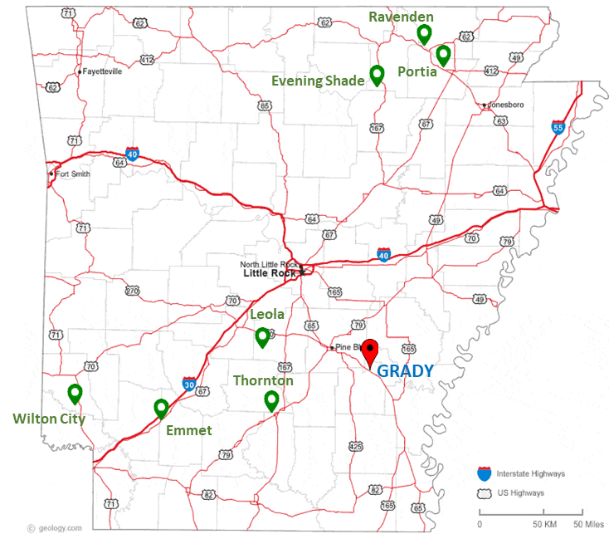
Matched Pairs Selection Example: Grady Bypass
City | County | Setting | Difference % | Remarks
Emmet | Nevada | Metro | 7% | Near Interstate
Evening Shade | Sharp | Rural | 8% | Different setting
Ravenden | Lawrence | Rural | 9% | Different setting
Thornton | Calhoun | Metro | 9% | Has a Bypass
Portia | Lawrence | Rural | 11% | Different Setting
Wilton City | Little River | Metro | 15% | Southwest
Leola | Grant | Metro | 15% | MATCH!

Slide 38
Matched Pairs: Proposed List of Matched Cities
Type | Project City | Matched City | Matched Percentage
Bypass | Grady | Leola | 85%
 | Hardy | Viola | 81%
 | Sheridan | Rockwell | 80%
 | Vilonia | East End | 78%
 | Flippin | Mammoth Spring | 84%
Widening | Gould | Waldo | 88%
 | Siloam Springs | Batesville | 88%
No Improvement | Dover | Newark | 91%
 | Green Forest | Booneville | 79%

Slide 39
Next Step: Interviews and survey assessment of impacts
ARDOT
Businesses
Citizens
Image from: https://www.risesmart.com/sites/default/files/blog-images/employee_focus_groups.jpg
Notes:
Those were the findings about the potential study sites so far, based on project documents provided by ARDOT and external sources.
Next steps: After deciding together with ARDOT which are the sites that will be included in the scope of analysis,
1. Economic impact of project “investments” using IMPLAN economic
analysis tool (Jebaraj)
2. Matched Pairs analysis (Rahman) – to compare study sites with control sites (sites with no improvement, of similar characteristics in terms of population , population density, per capita income, and economic distress). For the matched pairs we will look at radial graphs too.
3. Social impacts and interpretation of economic impacts through on
site surveys/interviews (Hernandez)
4. Safety impacts using crash data (Hernandez)

Slide 40
Questions?
Dr. Sarah Hernandez (PI) | sarahvh@uark.edu | 479-575-4182

